Slide 1
Strengthening Supervision:
Agreement Setting and Managing from the Middle
Supervision Slide Master
© 2015 Scott Migdole

Slide 2
Strengthening Supervision:
Agreement Setting and Managing from the Middle
Scott Migdole, M.S.W., LCSW
Yale University School of Medicine
Program on Supervision

Slide 3
Getting Started

Slide 4
Increased Need for Supervision
Larger case-loads
Greater staff autonomy
Increasing individual complexity (e.g., co-occurring illnesses & medical co-morbidity)
Greater risk
Increased service complexity (e.g., EBPs)
Increased systems complexity

Slide 5
Status of Supervision Nationally
Delivered “ad hoc” if at all
Supervisors eliminated as organizations have been “flattened” & Supervisors distracted by dual roles
Many organizations don’t support it:
  Insufficient training of new supervisors
  Time for supervision not allocated
  No supervision standards or monitoring
  Replaced with team, staff, & peer mtgs

Slide 6
IN MANY ORGANIZATIONS….
SUPERVISION HAS BECOME…..

Slide 7


Slide 8

SNOOPervision
ssssssss

Slide 9
BUT ONE THING WE KNOW FOR SURE….
SUPERVISION WILL ALWAYS BE….

Slide 10
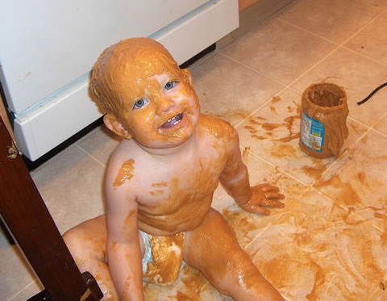
We know it’s messy!

Slide 11
Program Content
Definition of Supervision
Basics of a Supervision Model
Three phases of supervision
Four Functions of supervision
Emphasis on the Supervision Agreement
III. Managing from the Middle

Slide 12
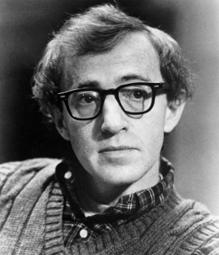
“80% Of Success Involves Just Showing Up”
Your Responsibilities
There is no quiz or test
We hope that you’ll participate.

Slide 13
What is Supervision?

Slide 14
A Definition
Supervision is a relationship in which one individual has authority and responsibility for the work and work life of another.
Related Concepts
  Consultation
  Peer “supervision”

Slide 15
Meeting the Minimum Standard
“Do no harm”
Assessing risk
Accessing help in a crisis

Slide 16
Structuring Supervision into a Model

Slide 17
Why Do We Need a Model ?
Structure Vs. Interpersonal
Support & Accountability along a continuum
Genuine Working Relationships
Ensuring the Work Gets Done

Slide 18
3 Phases of Supervision
Engagement Phase (Roles & Responsibilities)
Work Phase (4 Functions)
Ending & Transition Phase

Slide 19
4 Functions of Supervision
Quality of Service
Administration
Support
Professional Development
Multi-tasking & constantly shifting focus

Slide 20
Engagement Phase
Strong Working Relationships through Structure /Genuineness/Accountability & Support
Structure Versus Interpersonal Relationships

Slide 21
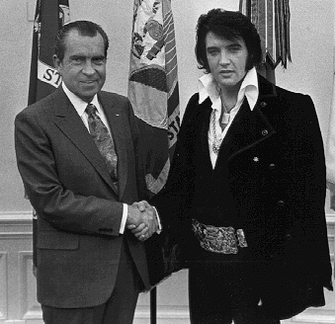
Engagement Phase

Slide 22
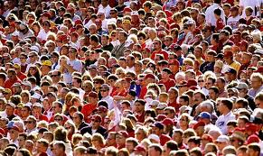
1. Who are my supervisors?
The roles and responsibilities of each
Who to turn to in their absence
After hours supervisory coverage
Chain of Command

Slide 23
2. What Kind of Meetings Will We Have?
How often will we meet?
How long will we meet?
Will it be individual and/or group supervision?
What if I need to cancel?

Slide 24
3. Are You Qualified to Supervise Me?
Supervisee’s concerns or question
AND
Supervisor’s personal doubts

Slide 25
4. Explaining the Purpose of Supervision
Ensure quality of service
Meet administrative requirements
Provide professional development
Support staff

Slide 26
5. Session Agenda
Have standing agenda items
Ask the supervisee to bring proposed agenda items to each session
Collaborate in quickly setting a handwritten session agenda
Be responsive to supervisee’s stated and unstated priorities (look for clues)
Document in the required format

Slide 27
6. Evaluating Performance
You’ll get a copy:
  job description
  expected competencies
  performance review form with criteria (focus on behavioral indicators)
Ongoing feedback
Annual review

Slide 28
7. Addressing “Confidentiality”
No information is truly confidential
Supervisors handle sensitive information carefully … and don’t actually share most of it.
Information used for crisis intervention, mandated reporting, performance reviews, personnel actions, and maintaining staff safety
Secrets (especially about clients) are never OK!

Slide 29

8. Dual Relationships: Promoted From Within
What Types of Dual Relationships Are There?

Slide 30
9. Your rights
Respect
Dignity
Cultural sensitivity
Free of abuse/harassment

Slide 31
10 What if we disagree?
Can I go over your head?

Slide 32
“Caught in the Middle”

Slide 33
Caught in the Middle
Being “Caught in the Middle” is part of the supervisor’s job and establishing strategies to manage it are what separates effective and ineffective supervisors

Slide 34
Coping Strategies of Middles
Sliding Up: The tendency for Middles to overly identify with the Uppers as a way of reducing the stress of the middle role.
Sliding Down: The tendency of the Middles to overly identify with the Lowers as a way of reducing the stress of the middle role.
Sliding Out: The tendency of the Middles to side step an issue rather than to be clear or avoid taking a position as a way of reducing the stress of the middle role.

Slide 35
Recommendations for Effectively Managing the Middle
Embrace Your Middleness.
Accept that the stress associated with being in
the Middle occurs in every organization and is
normal.
Resist the Temptations to slide up, down, or
out.
Understand the power of informal groups

Slide 36
Recommendations for Effectively Managing the Middle
Build and maintain relationships with Uppers
and Lowers.
Tell the whole story.
Keep people connected by bringing them
together.
Operate under the assumption that there are
no facts, just perspectives.

Slide 37
Conclusion
Agreement Setting
Strong Working Relationships
Accountability and Support
Managing from the Middle
Supervisors are our most valuable resource!

Slide 38

Thanks!
Got a Question?
Scott.migdole@yale.edu
Notes:
37

