Slide 1
Take Action Now: Advocating for Your Legislative Priorities
Andy Dodson
NABH Vice President of Government Relations
Emily Wilkins
NABH Director of Government Relations

Slide 2
NABH Advocacy Tools
NABH Government Affairs Team
Coalitions
Hill Day
Government Relations Network/GRN
Grassroots
Site Visits
NABH Champions PAC

Slide 3
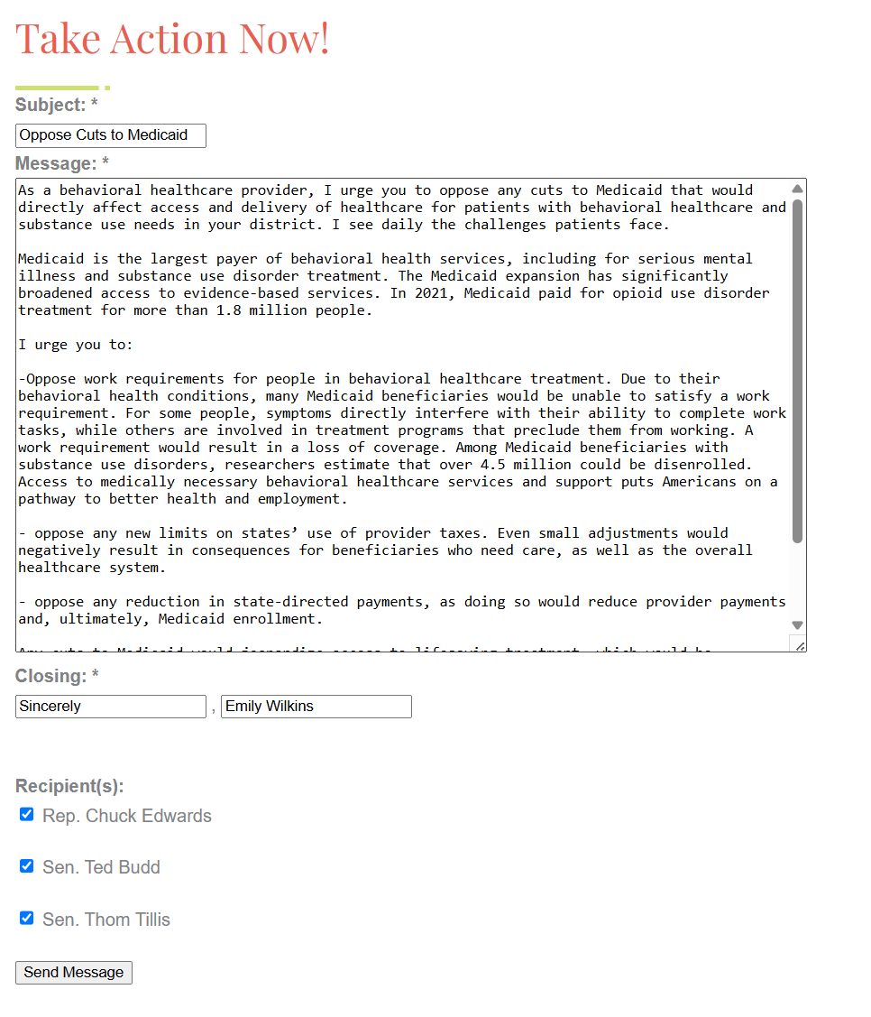
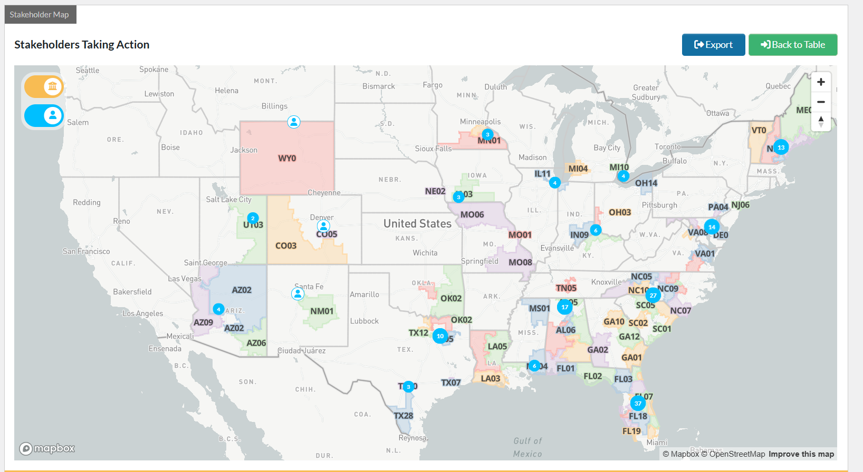
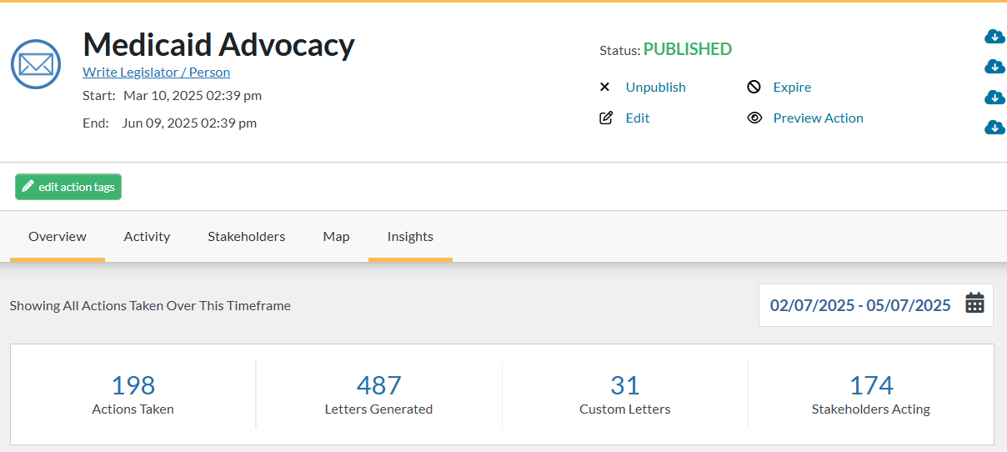
Grassroots = Impact!

Slide 4
Site Visits

Slide 5
NABH Champions PAC

Slide 6
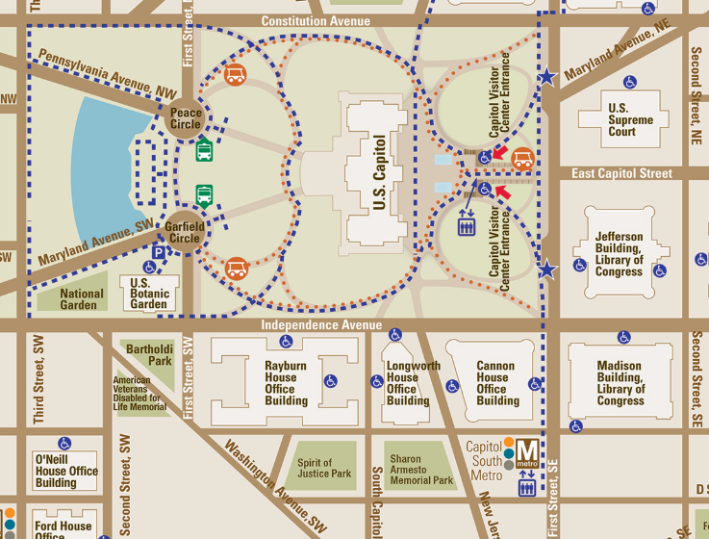
Hill Day 2025
Day Of Contact:
Emily Wilkins
Emily@nabh.org
571-438-0389
Basecamp: Capitol Hill Club

