Slide 1
Examining Today’s Telemedicine & Telehealth Landscape
May 2025

Slide 2
ATA Action Advocacy Ally Federal Policy Priorities
Legislative | Regulatory
Permanent Medicare Telehealth Coverage Geographic and originating site waivers Audio only coverage RHCs and FQHCs considered distant sites & reimbursed at a fair rate Expansion of Medicare provider list Waiving the telemental health in-person requirement Continuation of Acute Hospital Care at Home Program Reinstate in-home cardiopulmonary flexibility Expand Medicare Diabetes Prevention Program (MDPP) | Remote Prescribing of Controlled Substances
First Dollar Coverage of High Deductible Health Plans – Health Savings Accounts (HDHP-HSAs) | Box 32: Provider Home Address Issue
Telehealth as an excepted benefit | Other issues: remote monitoring, Medicare Advantage, broadband, AI, privacy

Slide 3
History of Medicare Telehealth Flexibilities
Prior to the pandemic, a provider and patient had to be in a rural area in a specific designated originating sites to be able to receive a telehealth visit.
Congress quickly implemented the Medicare telehealth flexibilities in the CARES Act, which waived the geographic and originating site restrictions among other items.
Consolidated Appropriations Act (CAA) of 2022 extended for 151 days post PHE.
2019
2020
March 2022
Consolidated Appropriations Act (CAA) of 2023 extended through CY2024.
American Relief Act, 2025 extended through March 30, 2025.
Full-Year Continuing Appropriations and Extensions Act extended through Sept 30, 2025.
December 2022
December 2024
March 2025

Slide 4
Current State of Telehealth
Congress extended certain Medicare telehealth flexibilities have through September 30, 2025.
Telehealth Provision | Included in CR
Waiving geographic and originating site requirements
Telemental health in-person requirement waiver
Audio-only coverage
Allowing RHCs and FQHCs to be distant site providers
Expansion of Medicare providers list
Acute Hospital Care at Home Program

Slide 5
Telehealth Provisions Excluded from Congressional Extension
First dollar coverage of telehealth in High-Deductible Health Plans – Health Savings Accounts
In-home Cardiopulmonary Rehabilitation Services flexibility
Expansion of the Medicare Diabetes Prevention Program Model
Telehealth as an excepted benefit
Removing the in-person requirement for the remote prescribing of controlled substances
Notes:
aims to amend existing healthcare policies to make it easier for patients to receive cardiopulmonary rehabilitation services in their homes, particularly through telehealth options.

Slide 6
History of the Remote Prescribing of Controlled Substances
2008
A law entitled “the Ryan Haight Act” was enacted requiring the DEA to activate a special registration allowing DEA licensed providers to prescribe CS via telehealth without an in-person exam. The DEA had no more than a year to complete the task, which they did not do.
Jan 2020
Due to the COVID-19 pandemic, DEA announced they were waiving the in-person requirement for the prescription of CS via telehealth throughout the duration of the PHE. Extensions continued through CY2024.
Dec 2024
DEA announced another extension of the COVID-19 remote prescription of controlled substances flexibilities through the end of CY2025.
Jan 2025
DEA releases Special Registration proposed rule (60-day comment ended March 18) and Buprenorphine final rule (effective date postponed to December 31, 2025)

Slide 7
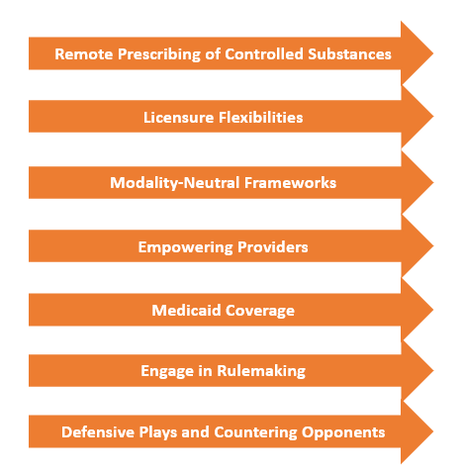
ATA Action State Advocacy
Since its inception in 2022, ATA Action has engaged in all 50 states through advocacy on legislation and regulation, guided by the ATA’s Policy Principles.
Tracked more than 1,200 bills and regulations
Commented on approximately 280 unique bills and regulations
Met with legislators or regulators in 20+ States
Retained lobbyists in 3 states

