Slide 1



Behavioral Health Technician
Registered Apprenticeship Program
The NABH Education and Research Foundation will identify
two to three NABH system members who will serve as
pilot program participants.
Identified participants will hire apprentices to participate in the program as full-time employees.
As part of this commitment, the NABH Education and Research Foundation will also develop the curriculum to support the apprenticeship program.

Slide 2

Why Apprenticeships?
Develop a solution for your system’s workforce recruitment
and retention challenges.
Improve patient care.
Create pathways in behavioral healthcare.
Invest in your team’s professional development.
Drive economic growth in your communities.

Slide 3





Behavioral healthcare career path
Career Exploration
Pre-Apprenticeship
Apprentice* / College Degree
Professional
Student worker
Job shadow
Social services volunteer
Intern
Behavioral health tech
Outreach specialist
Behavioral health clinician
Licensed mental health professional
Psychologist
Psychiatrist
* High school degree

Slide 4
Next Steps
NABH will select a Registered Apprenticeship Program Task Force to work with the NABH Quality Committee
to design curriculum, on-the-job learning, and
certification requirements.

Slide 5
Next Steps
What can your system do?
Express interest in serving on the Registered Apprenticeship Program Task Force.
Provide feedback and support to the Registered Apprenticeship Program Task Force.
Understand there is no expectation that you participate now. There will be opportunities to join after NABH develops the Registered Apprenticeship Program.

Slide 6

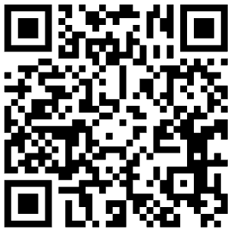
Survey Directions
Scan QR code or join by web at: PollEv.com​/nabh1020.
Please enter your name, click “continue” and take the survey.

Slide 7

Thank you for joining us today!
Jim Shaheen
John Pallasch
Kristen Weeden
Jessica Zigmond
jim.shaheen@cmglp.com
john@oneworkforcesolutions.com
kristen.nelsonweeden@outlook.com
jessica@nabh.org

